Slide 1
Pizzamordle
CSS 475 - Database Systems
19 March 2025
The Immordlers
Karsten Schmidt, Keisuke Maeda, Benjamin Findley, Jac Chambers

Slide 2
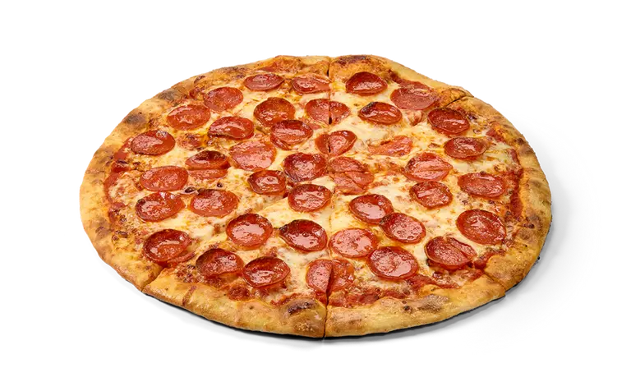
Business Problem
Small, independent pizza shops struggle to analyze and track customer purchases effectively. Most rely on basic point-of-sale systems that lack advanced analytics on sales trends.
Without data-driven insights, these shops cannot optimize pricing, identify popular items, or track peak sales hours.
Larger pizza chains use sophisticated analytics to improve profitability and efficiency, creating a competitive disadvantage for smaller shops.

Slide 3

Solution
An automated order analysis system can provide critical insights into customer preferences, helping small pizza shops make informed business decisions.
Tracking gross revenue instead of profit simplifies the focus on popularity and sales analytics, avoiding unnecessary complexity in cost management.

Slide 4
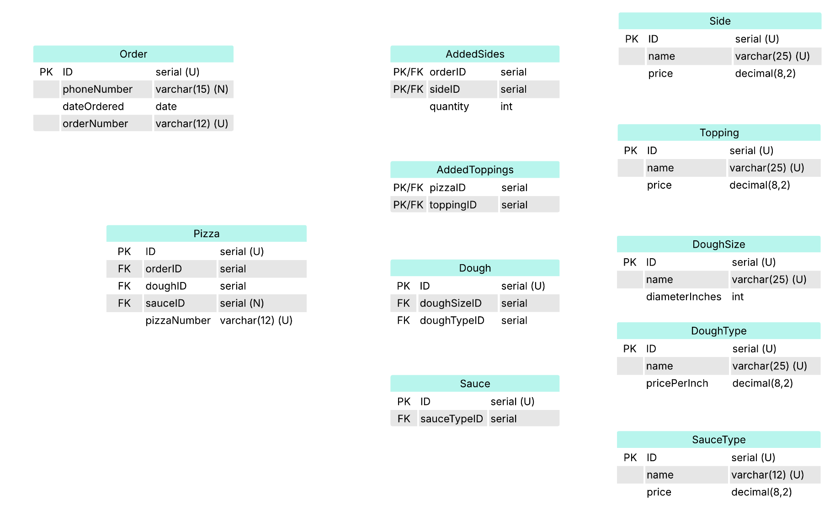
Schema

Slide 5
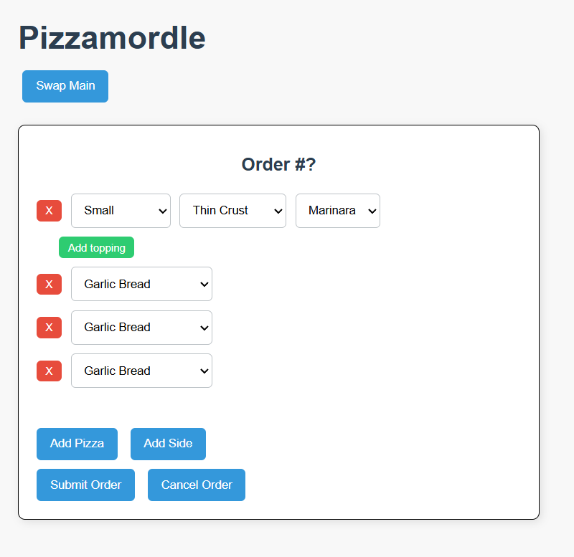
Demonstration

